Slide 1

Virtual Roll Call
Team Member(s): Eric Fernandez, Oscar A Yannelli Product Owner: Jason Cohen
Instructor: Masoud Sadjadi School of Computing and Information Sciences Florida International University
Final Presentation
Summer 2017
Notes:
7 seconds.( I will select 2 best slides (i will give them extra points and students will present for CIS committee)
Greet your audience, thank them for attending your presentation, introduce yourself, introduce your project, introduce your team members, and quickly indicate what each of you did in a high-level manner, and put more emphasis on your part/contribution.

Slide 2
Project definition
Police Officers use a roll call system as a means to relay important information at the beginning of each shift. Unfortunately, many officers are sometimes unable to attend roll due to various circumstances such as traffic, court obligations, and early assignments. Virtual Roll Call was a solution deemed fit by the Pinecrest Police Department in order to allow officers to view information provided at roll call at their earliest convenience, without missing any vital information.
Virtual Roll Call is a web application that allows Supervisors to upload documents to the system, and Officers to view/download these documents. The application is completely customizable by Administrators, who can add/edit/delete users from the system, add categories to upload documents under, and change logo and the department name, so that other police departments can use the system in the future.
By having the roll call system virtualized, officers are always up to date on the latest briefings, and can carry out their tasks efficiently, which will be a great service to the community as a whole.
Notes:
10 seconds.
Introduce the problem that the whole project (in all versions) tackles with GIF or screenshot.

Slide 3
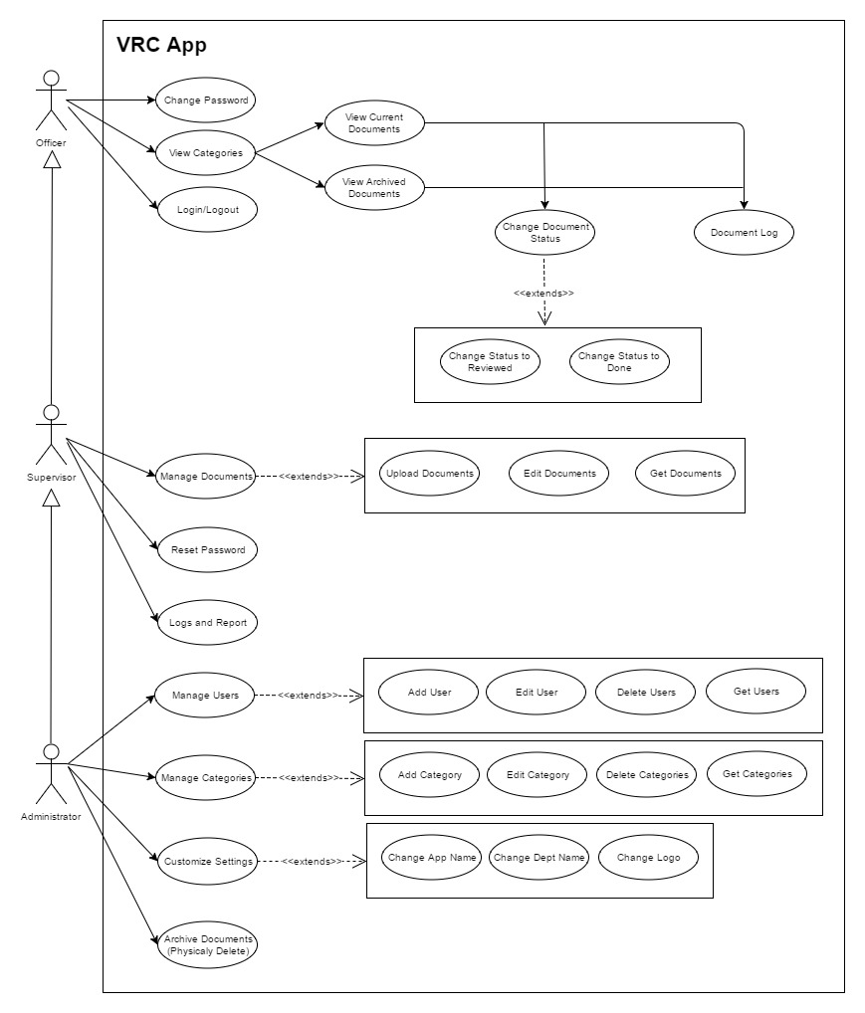
Requirements: Use Cases
Notes:
5 seconds
Show the Use Case Diagram for the whole project. Highlight your use cases.

Slide 4
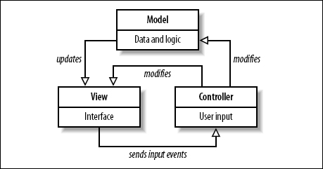
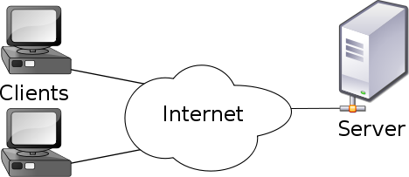
System Design: Architecture
Model-View Controller
Model-View-Controller is an architectural pattern commonly used for designing web applications. As the name implies, there are 3 major components in the architecture:
1. Model – manages the data and logic of the application
2. View – The User Interface of the application
3. Controller – Receives user input and modifies data in the model
Client-Server Model
Our system uses the Client-Server model, which is an application structure used in distributed applications. The client makes requests to the server via the internet,, and the server responds to the client with the requested function.. Virtual Roll Call is hosted on a Linux Ubuntu virtual machine, and clients are able to use the application and perform actions through the server.
Notes:
20 seconds
System design: Highlight the parts that you contributed to them.
1. System decomposition; identify the architecture patterns used
2. System deployment – h/w and s/w requirements

Slide 5
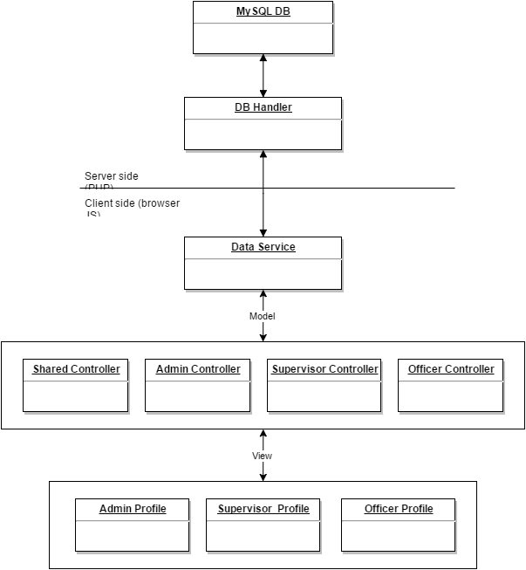
Minimal Class Diagram
Notes:
10 seconds.Minimal class diagram. Highlight the classes that you created/modified
Identify the design patterns used (one or more slides).

Slide 6
User Stories
1. User Story 249: View Document
2. User Story 233: Add Document Confirmation
3. User Story 244: Add User Log
4. User Story 231: Change Role View
5. User Story 245: Archived Documents
Notes:
5 seconds.
List the user stories that you worked on them.(put in order of importance). Stay focused on the parts that you have been working.

Slide 7
User Story #249 View Doc in App
As an officer, I would like to view documents within the app versus downloading it to my computer so that I can quickly traverse the information my supervisor is sharing with me.
This User Story is only for the Officer.
The Officer will move faster by seeing the document with one click and not having to download the document.
Only the Documents supported by the browser can be seeing (PDF and Images).
The Document will be show in a new tab.
Notes:
60 seconds
The tile of user story
The most important user story you worked on it. You have to describe this one very well and be proud of that.
Please present and show the complexity of your work, code, algorithms, and technical challenges and technologies you have used. (you could use screenshot if you want. Visual presentations are better than text presentation)
Go into the details of the most important/significant tasks using bullet lists or visual graphs or state chart diagram
Sequence Diagram for this user story is mandatory (in another separate page if required)
Demo using screenshots or GIF (in another separate page if required)

Slide 8
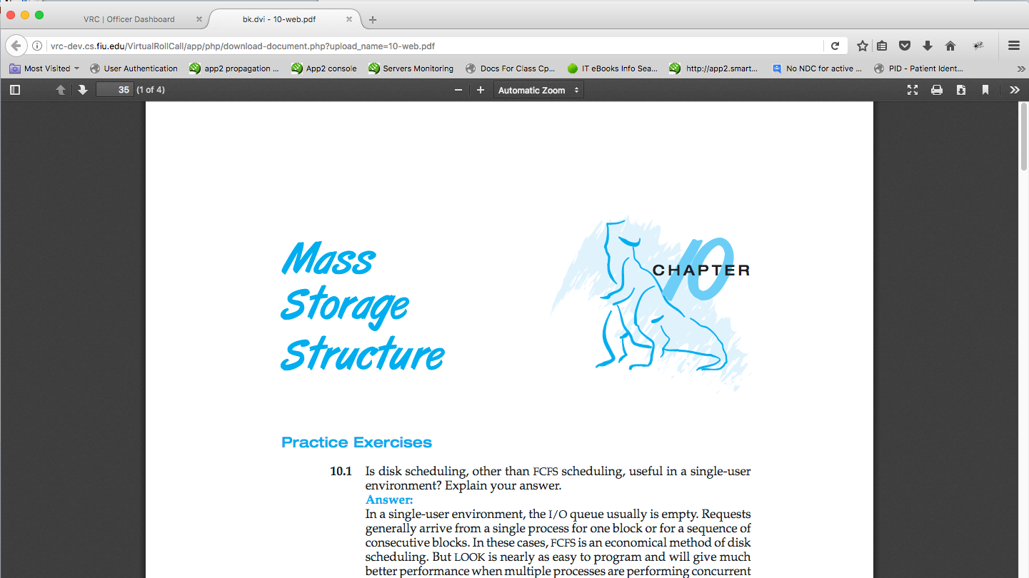
Notes:
20 seconds
The tile of user story
Please present and show the complexity of your work, code, algorithms, and technical challenges and technologies you have used. (you could use screenshot if you want. Visual presentations are better than text presentation) - Go into the details of the most important/significant tasks using bullet lists or visual graphs or state chart diagram - Demo using screenshots or GIF (in another separate page if required)
Sequence Diagram for this user story is optional

Slide 9
User Story #233 Add Doc Confirmation
As a Supervisor, I would like that newly added documents to show with status “Pending”, then when the officer clicks on the document for the first time change the status to “Reviewed” and finally change it to “Done” once he/she finished.
When the Officer click on a document the document change from Pending to review.
When the Officer finish read the document can accept the reading and the document will change status to done.
In the logs for the supervisor the time the Officer spend reading the document will be shown
Notes:
20 seconds
The tile of user story
Please present and show the complexity of your work, code, algorithms, and technical challenges and technologies you have used. (you could use screenshot if you want. Visual presentations are better than text presentation) - Go into the details of the most important/significant tasks using bullet lists or visual graphs or state chart diagram - Demo using screenshots or GIF (in another separate page if required)
Sequence Diagram for this user story is optional

Slide 10
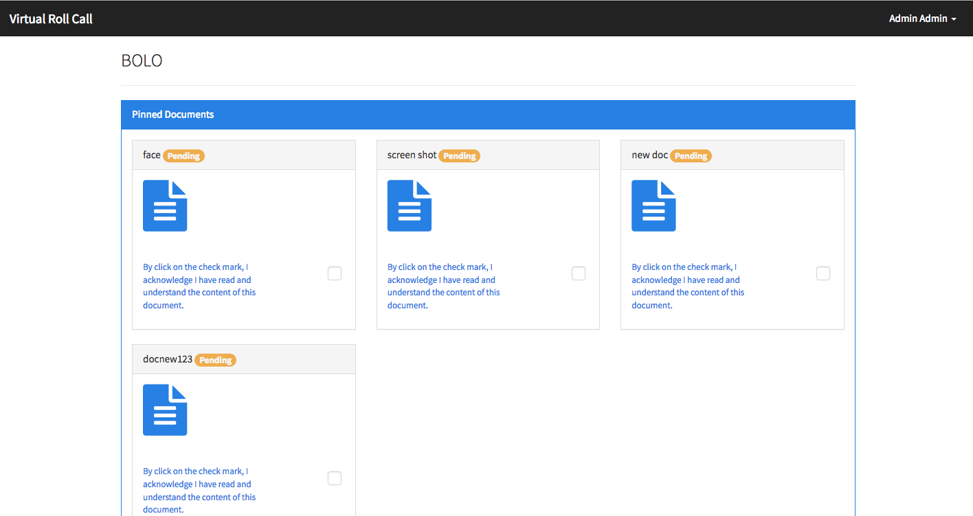
Notes:
20 seconds
The tile of user story
Please present and show the complexity of your work, code, algorithms, and technical challenges and technologies you have used. (you could use screenshot if you want. Visual presentations are better than text presentation) - Go into the details of the most important/significant tasks using bullet lists or visual graphs or state chart diagram - Demo using screenshots or GIF (in another separate page if required)
Sequence Diagram for this user story is optional

Slide 11
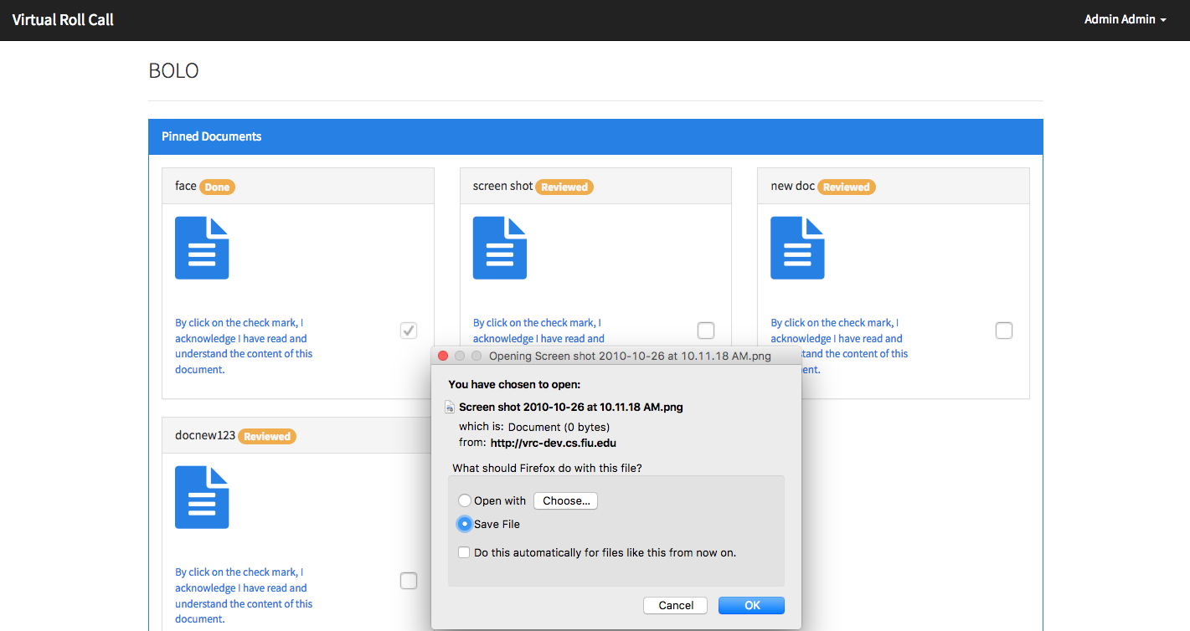
Notes:
20 seconds
The tile of user story
Please present and show the complexity of your work, code, algorithms, and technical challenges and technologies you have used. (you could use screenshot if you want. Visual presentations are better than text presentation) - Go into the details of the most important/significant tasks using bullet lists or visual graphs or state chart diagram - Demo using screenshots or GIF (in another separate page if required)
Sequence Diagram for this user story is optional

Slide 12
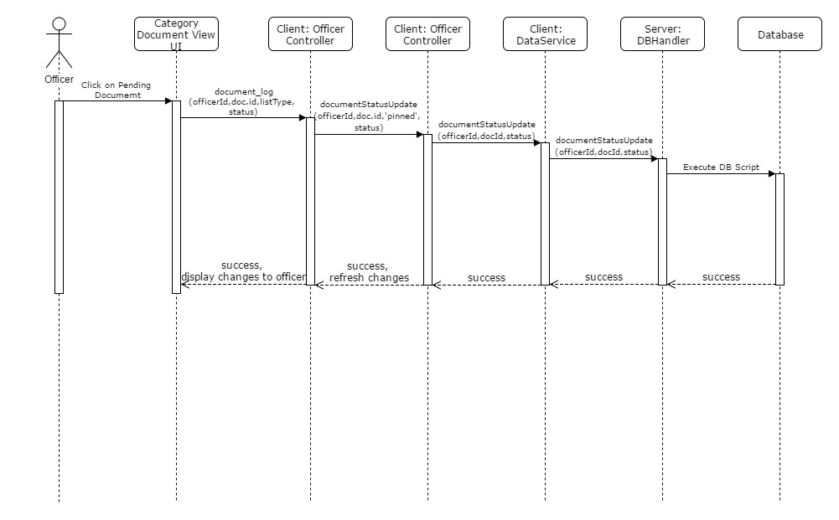
Notes:
20 seconds
The tile of user story
Please present and show the complexity of your work, code, algorithms, and technical challenges and technologies you have used. (you could use screenshot if you want. Visual presentations are better than text presentation) - Go into the details of the most important/significant tasks using bullet lists or visual graphs or state chart diagram - Demo using screenshots or GIF (in another separate page if required)
Sequence Diagram for this user story is optional

Slide 13
User Story #244 Add User Log
Every time an officer accesses a document the log has to save this action, by recording the user the date and the document acceded. There is need of showing this information in the supervisor profile
The system will record every time a Officer clicks on a document, saving the document, the Officer, the time.
When the Officer, click done with the document, the Logs will show the status and the time of reading of the document.
The logs can not be deleted.
Only the supervisor will have access to the logs.
Notes:
20 seconds
The tile of user story
Please present and show the complexity of your work, code, algorithms, and technical challenges and technologies you have used. (you could use screenshot if you want. Visual presentations are better than text presentation) - Go into the details of the most important/significant tasks using bullet lists or visual graphs or state chart diagram - Demo using screenshots or GIF (in another separate page if required)
Sequence Diagram for this user story is optional

Slide 14
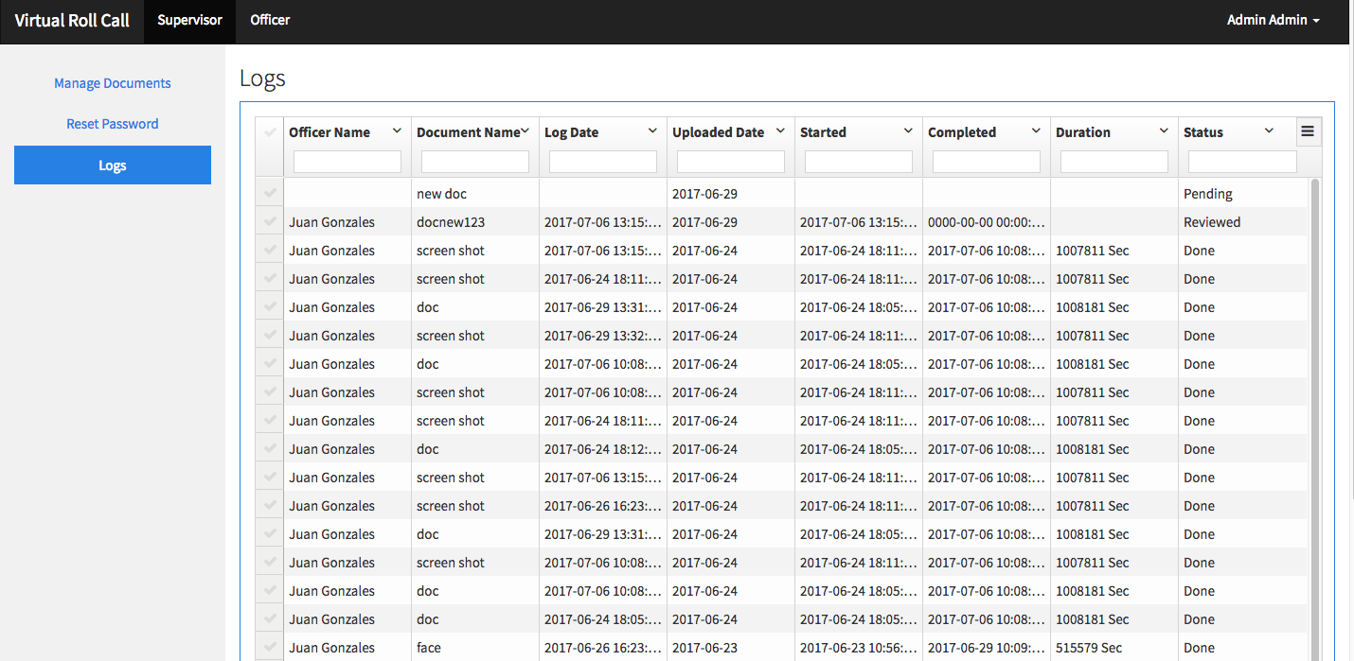
Notes:
20 seconds
The tile of user story
Please present and show the complexity of your work, code, algorithms, and technical challenges and technologies you have used. (you could use screenshot if you want. Visual presentations are better than text presentation) - Go into the details of the most important/significant tasks using bullet lists or visual graphs or state chart diagram - Demo using screenshots or GIF (in another separate page if required)
Sequence Diagram for this user story is optional

Slide 15
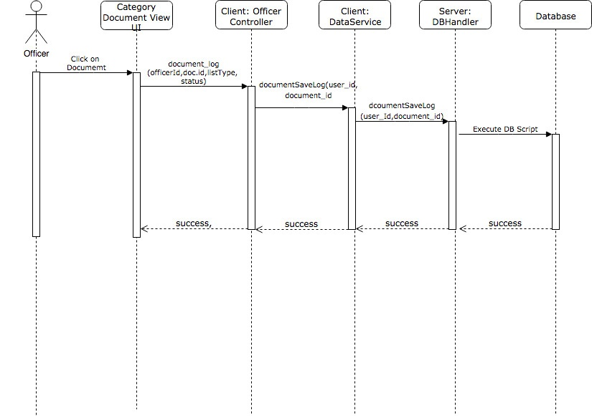
Notes:
20 seconds
The tile of user story
Please present and show the complexity of your work, code, algorithms, and technical challenges and technologies you have used. (you could use screenshot if you want. Visual presentations are better than text presentation) - Go into the details of the most important/significant tasks using bullet lists or visual graphs or state chart diagram - Demo using screenshots or GIF (in another separate page if required)
Sequence Diagram for this user story is optional

Slide 16
User Story #231 Change Role View
As an Administrator, I would like to change my role based view to Supervisor or Officer, so that I can check that customization additions and documents are being added properly
The Administrator can see the page as an supervisor
The supervisor can see the page as an Officer
The Supervisor, can add a document and go to the Officer view and check the Document is in the right category and is showing the right way without to have to logout.
Notes:
20 seconds
The tile of user story
Please present and show the complexity of your work, code, algorithms, and technical challenges and technologies you have used. (you could use screenshot if you want. Visual presentations are better than text presentation) - Go into the details of the most important/significant tasks using bullet lists or visual graphs or state chart diagram - Demo using screenshots or GIF (in another separate page if required)
Sequence Diagram for this user story is optional

Slide 17
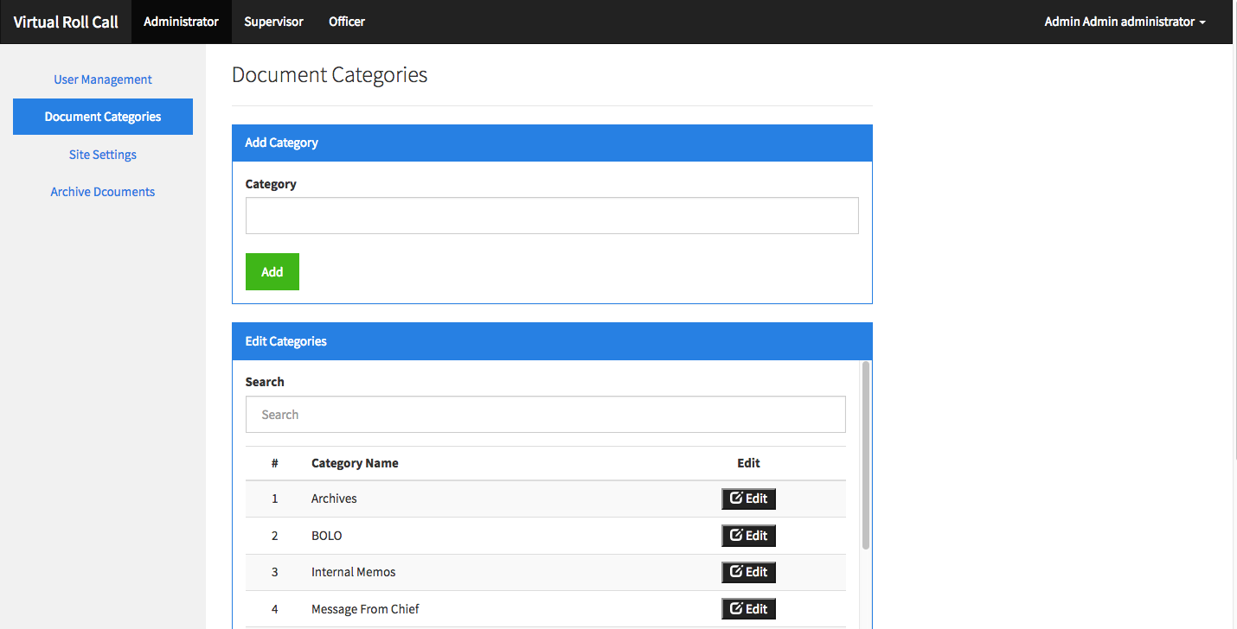
Notes:
20 seconds
The tile of user story
Please present and show the complexity of your work, code, algorithms, and technical challenges and technologies you have used. (you could use screenshot if you want. Visual presentations are better than text presentation) - Go into the details of the most important/significant tasks using bullet lists or visual graphs or state chart diagram - Demo using screenshots or GIF (in another separate page if required)
Sequence Diagram for this user story is optional

Slide 18
User Story #245 Archived Documents
As a officer I will like to have all documents older than 7 days moved. As an administrator, I like the option to physically delete documents based on a date range
Documents older than 7 days should not show in the categories for the Officer unless they are pinned Documents.
The archive Documents will be shown in a link under the categories, and will show the older than 7 days that are not pinned.
The physical archive, will be possible only by the Administrator, which can enter a range of dates and all the Documents enter in this range will be deleted, except the pinned
Notes:
20 seconds
The tile of user story
Please present and show the complexity of your work, code, algorithms, and technical challenges and technologies you have used. (you could use screenshot if you want. Visual presentations are better than text presentation) - Go into the details of the most important/significant tasks using bullet lists or visual graphs or state chart diagram - Demo using screenshots or GIF (in another separate page if required)
Sequence Diagram for this user story is optional

Slide 19
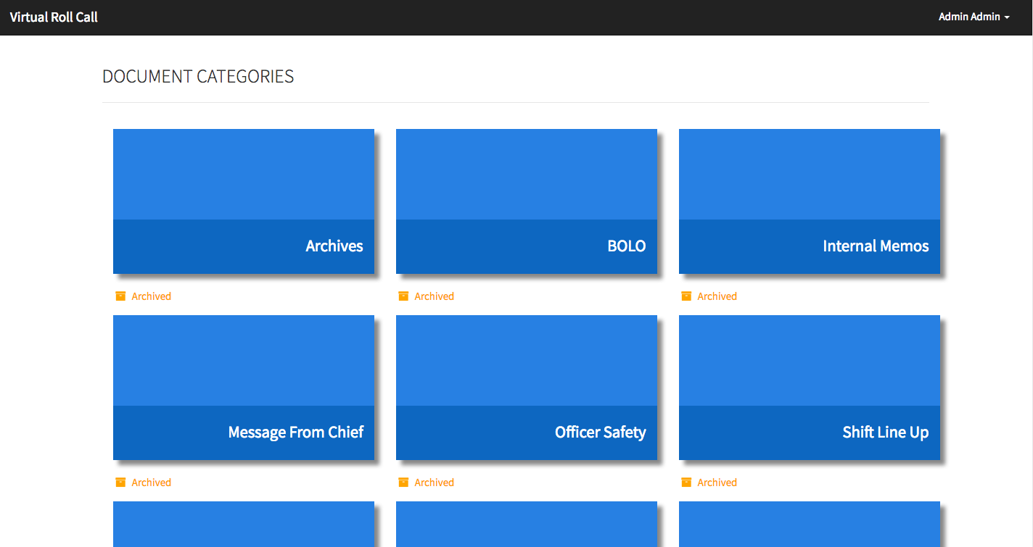
Notes:
20 seconds
The tile of user story
Please present and show the complexity of your work, code, algorithms, and technical challenges and technologies you have used. (you could use screenshot if you want. Visual presentations are better than text presentation) - Go into the details of the most important/significant tasks using bullet lists or visual graphs or state chart diagram - Demo using screenshots or GIF (in another separate page if required)
Sequence Diagram for this user story is optional

Slide 20
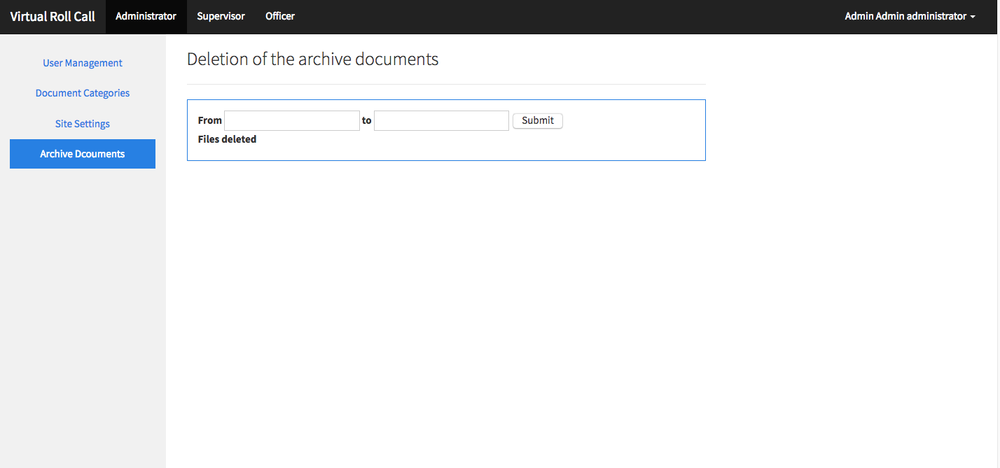
Notes:
20 seconds
The tile of user story
Please present and show the complexity of your work, code, algorithms, and technical challenges and technologies you have used. (you could use screenshot if you want. Visual presentations are better than text presentation) - Go into the details of the most important/significant tasks using bullet lists or visual graphs or state chart diagram - Demo using screenshots or GIF (in another separate page if required)
Sequence Diagram for this user story is optional

Slide 21
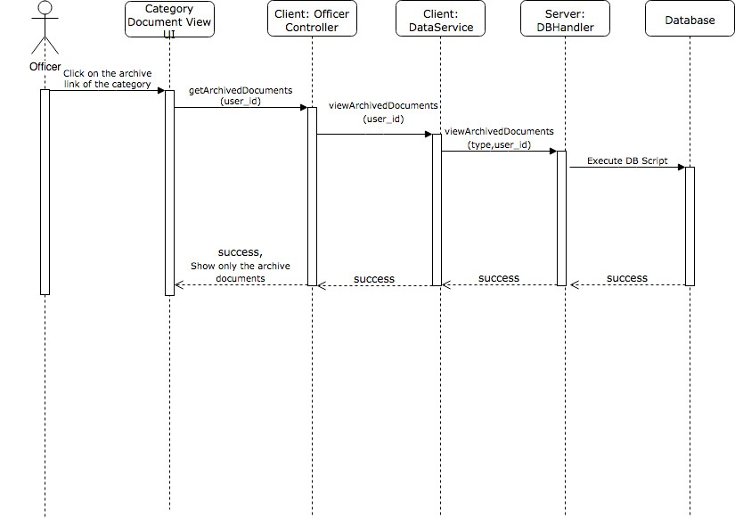
Notes:
10 seconds
A description of verification process and Test Suites and Test Cases for one of the use cases.
1 One sunny day and one rainy day for the implemented use cases (one or more slides).
2 Automated test scripts for the implemented use cases (if any) (one or more slides).

Slide 22
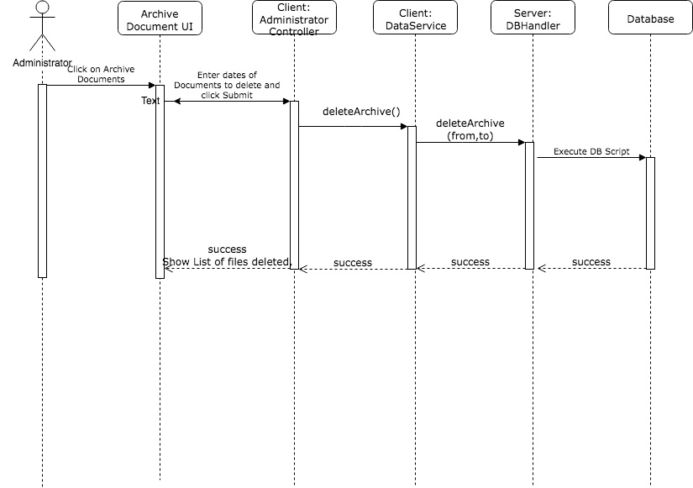
Notes:
10 seconds
A description of verification process and Test Suites and Test Cases for one of the use cases.
1 One sunny day and one rainy day for the implemented use cases (one or more slides).
2 Automated test scripts for the implemented use cases (if any) (one or more slides).

Slide 23
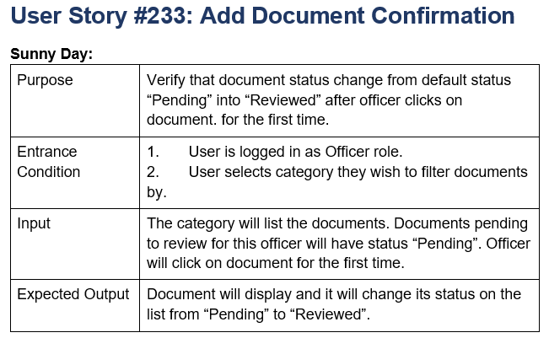
Test Cases
Notes:
10 seconds
A description of verification process and Test Suites and Test Cases for one of the use cases.
1 One sunny day and one rainy day for the implemented use cases (one or more slides).
2 Automated test scripts for the implemented use cases (if any) (one or more slides).

Slide 24
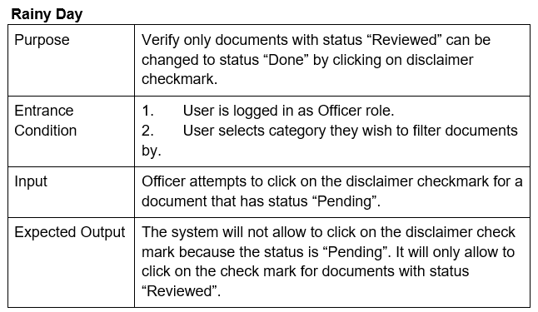
Test Cases
Notes:
10 seconds
A description of verification process and Test Suites and Test Cases for one of the use cases.
1 One sunny day and one rainy day for the implemented use cases (one or more slides).
2 Automated test scripts for the implemented use cases (if any) (one or more slides).

Slide 25
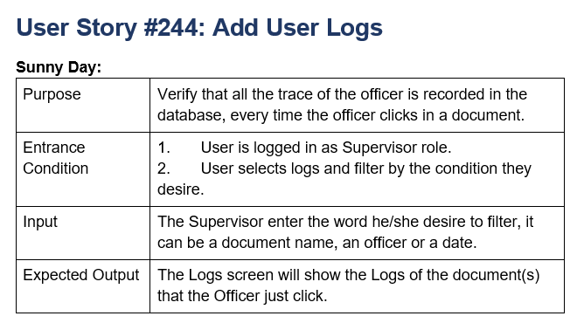
Test Cases
Notes:
10 seconds
A description of verification process and Test Suites and Test Cases for one of the use cases.
1 One sunny day and one rainy day for the implemented use cases (one or more slides).
2 Automated test scripts for the implemented use cases (if any) (one or more slides).

Slide 26
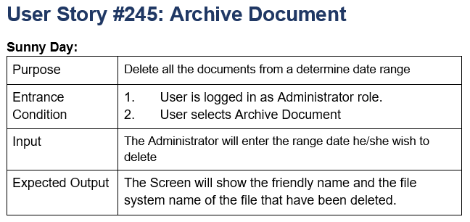
Test Cases
Notes:
10 seconds
A description of verification process and Test Suites and Test Cases for one of the use cases.
1 One sunny day and one rainy day for the implemented use cases (one or more slides).
2 Automated test scripts for the implemented use cases (if any) (one or more slides).

Slide 27
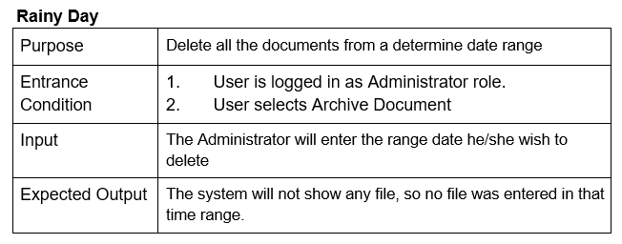
Test Cases
Notes:
10 seconds
A description of verification process and Test Suites and Test Cases for one of the use cases.
1 One sunny day and one rainy day for the implemented use cases (one or more slides).
2 Automated test scripts for the implemented use cases (if any) (one or more slides).

Slide 28
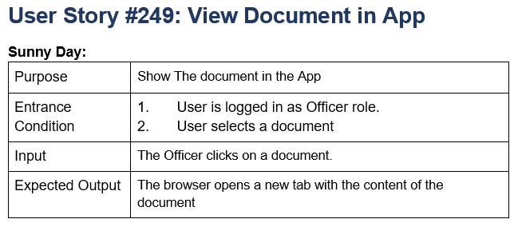
Test Cases
Notes:
10 seconds
A description of verification process and Test Suites and Test Cases for one of the use cases.
1 One sunny day and one rainy day for the implemented use cases (one or more slides).
2 Automated test scripts for the implemented use cases (if any) (one or more slides).

Slide 29
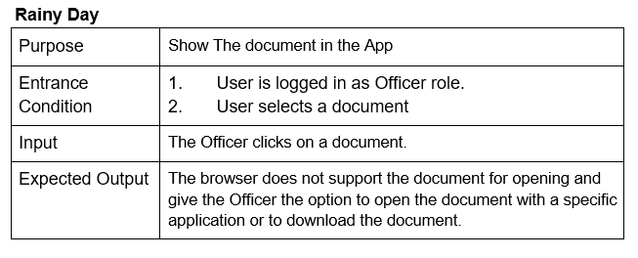
Test Cases
Notes:
10 seconds
A description of verification process and Test Suites and Test Cases for one of the use cases.
1 One sunny day and one rainy day for the implemented use cases (one or more slides).
2 Automated test scripts for the implemented use cases (if any) (one or more slides).

Slide 30
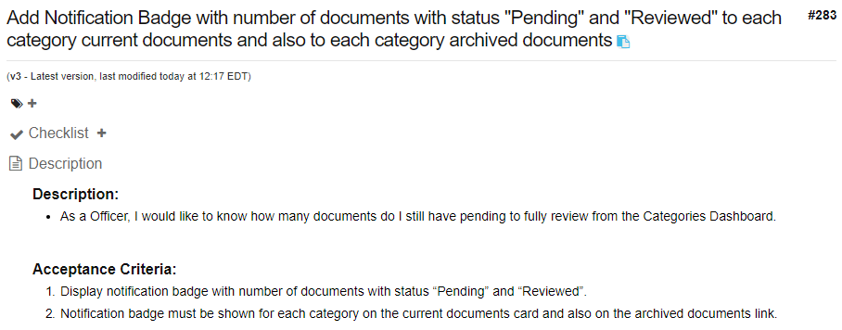
Shortcomings
Notes:
10 seconds.
Introduce the problem that the whole project (in all versions) tackles with GIF or screenshot.

Slide 31
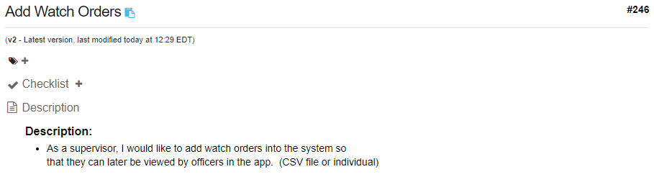
Shortcomings
Notes:
10 seconds.
Introduce the problem that the whole project (in all versions) tackles with GIF or screenshot.

Slide 32
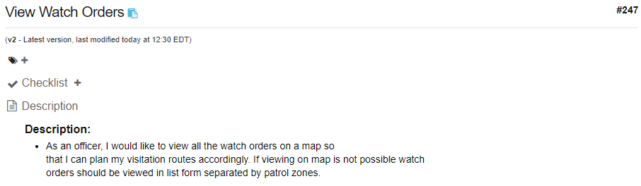
Shortcomings
Notes:
10 seconds.
Introduce the problem that the whole project (in all versions) tackles with GIF or screenshot.

Slide 33
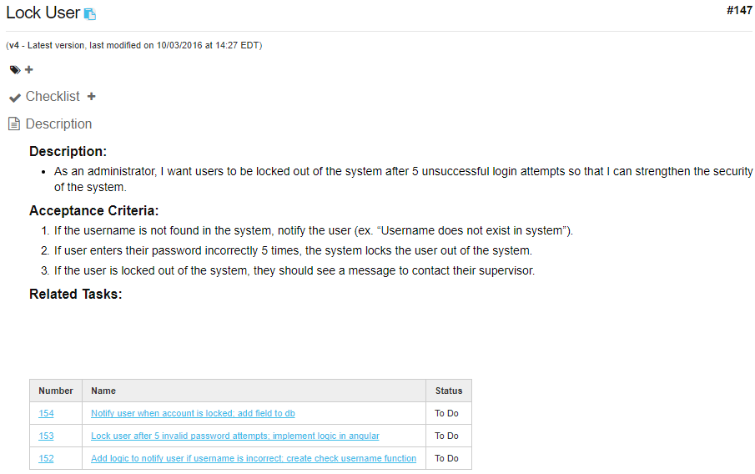
Shortcomings
Notes:
10 seconds.
Introduce the problem that the whole project (in all versions) tackles with GIF or screenshot.

Slide 34
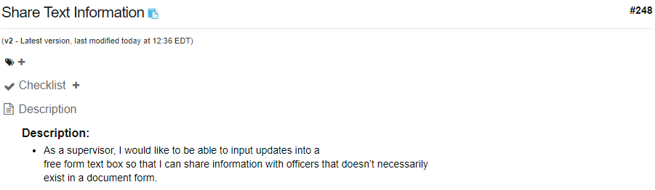
Shortcomings
Notes:
10 seconds.
Introduce the problem that the whole project (in all versions) tackles with GIF or screenshot.

Slide 35
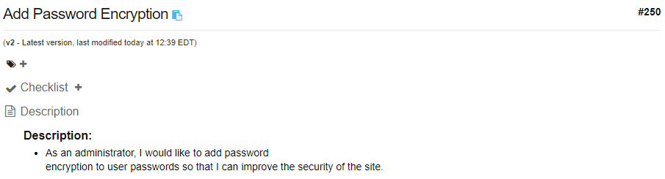
Wish List
Notes:
10 seconds.
Introduce the problem that the whole project (in all versions) tackles with GIF or screenshot.

Slide 36
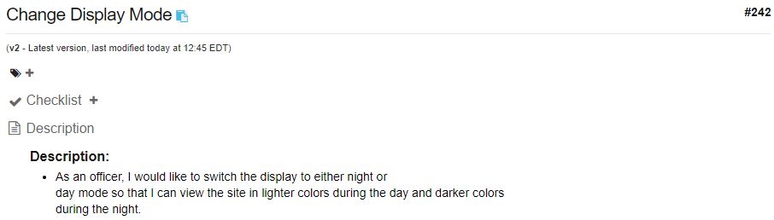
Wish List
Notes:
10 seconds.
Introduce the problem that the whole project (in all versions) tackles with GIF or screenshot.

Slide 37
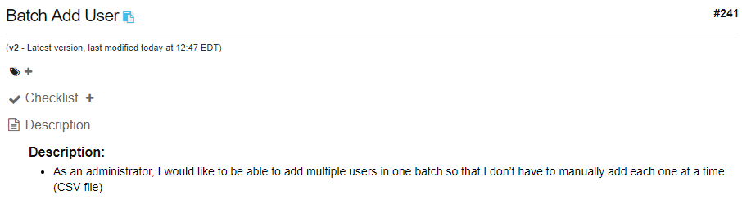
Wish List
Notes:
10 seconds.
Introduce the problem that the whole project (in all versions) tackles with GIF or screenshot.

Slide 38



Summary
Summary
We were able to fix previous bug and add required new features to start using app in production.
We did a lot of enhancement of user interface.
We managed to implement the new required features of Logs, Document Status and Document Confirmation.
We also implemented Report Capabilities with option to filter and option to Export Report to PDF and Excel.
Contact
Eric A. Fernandez (efern187@fiu.edu)
Oscar A. Yannelli (oyann001@fiu.edu)
Questions?
Thank You!
Notes:
10 seconds
Summarize your contribution, mention your effort for Scrum, Mingle, Github, Google Drive Documentation and minutes
Include your contact information
Ask if anyone has any questions for you.
Thank your audience

